Slide 1
CARDIAC ACTION POTENTIAL: IONIC BASIS

Slide 2
References
1.Clinical arrhythmology and electrophysiology, a companion to braunwald’s heart disease, third edition
2.Harrison’s principles of internal medicine,21st edition
3. Ganong’s review of medical physiology, 26th edition
4.Cardiac Ion Channels,Augustus O. Grant https://doi.org/10.1161/CIRCEP.108.789081Circulation: Arrhythmia and Electrophysiology. 2009;2:185–194
5.Cardiac transmembrane ion channels and action potentials: cellular physiology and arrhythmogenic behaviorAndrás Varró, Jakub Tomek, Norbert Nagy, László Virág, Elisa Passini, Blanca Rodriguez, and István Baczkó,András Varró
https://doi.org/10.1152/physrev.00024.2019

Slide 3
IONIC EQUILIBRIUM
Cell membrane is resistant to hydrophilic ion movement
Ions use specialized pores called channels to move across membrane
ion movement is driven by
1. Electrical gradient
2. Chemical gradient
Movement of ion is from higher gradient to lower gradient.
Most of the movements occur passively

Slide 4
electrical gradient becomes equal and opposite to the chemical gradient, the ion is said to be in electrochemical equilibrium
the electrical potential is called the equilibrium potential (E_{ion}) (reversal potential or Nernst potential) of that individual ion
No ion movement occurs at this potential
E_{ion} of an ion depends on its concentration on either side of the membrane

Slide 6
RESTING MEMBRANE POTENTIAL
It is the potential difference across the cell membrane at rest.
It is negative inside with respect to outside the membrane.
Cells in their resting state are said to be polarised
RMP is not same in all cardiac cells
-90mV in atrium, ventricles
-60mV in pacemaker cells
THRESHOLD POTENTIAL is the critical level to which the membrane potential must be depolarized to initiate an action potential

Slide 7
EXCITABILITY
Ease with which a cell respond to a stimulus with a regenerative action potential
In cardiac cells excitability depends on number of available Na⁺ channels
Sodium channels are more open at negative E_{m}
Cardiac cells with more negative Em(ventricles and atrium) are more excitable than SA node

Slide 8
REFRACTORINESS
Inability to initiate another action potential in response to stimulus of threshold intensity
Absolute refractory period: no stimulus, regardless of strength can re-excite the cell
Relative refractory period: suprathreshold stimulus can initiate action potential
Refractoriness in cardiac tissue is a function of Na⁺ channels

Slide 10
CARDIAC ACTION POTENTIAL
Action Potential is a sudden reversal of membrane polarity when a stimulus strikes the cell membrane.
Action potential in cardiac muscle is different from that of other tissues such as skeletal muscles and nerve tissues.
Duration of action potential in cardiac muscle is 250 to 350ms (0.25 to 0.35s)

Slide 11
CARDIAC ACTION POTENTIAL
Cardiac action potential is unique in itself
Not only it is different from action potential seen in other excitable tissues but different in different part of the heart
This heterogeneity is brought by differential distribution of various ionic channels
Cardiac Action potential are of two types
1.Fast response action potential : seen in atrium, ventricles
2. Slow response action potential: seen in SA node, AVN

Slide 12
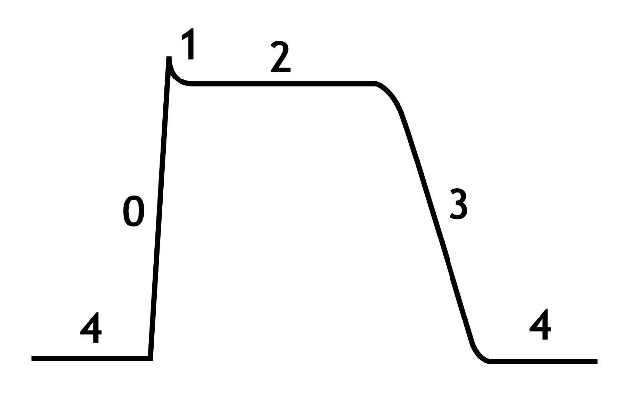
Phases of action potential
There are 5 phases
Phase 0: rapid depolarisation
Phase 1: early repolarisation
Phase 2 : plateau phase
Phase 3 : rapid repolarisation
Phase 4: resting membrane potential

Slide 13
FAST RESPONSE ACTION POTENTIAL

Slide 14
Phase 4: The Resting Membrane Potential
Caused by the different ionic concentration across the membrane and selective membrane permeability
At RMP, membrane is most permeable to K⁺ ions.
Hence E_{m} tends to be close to E_{k} (-94mV)
K_{ir} plays a major role in maintaining E_{m}
Resting E_{m} is also maintained by Na⁺⁻K⁺ ATPase pump
Intracellular Ca²⁺ also plays role via Na⁺-Ca²⁺ pump

Slide 15
Phase 0: The Upstroke rapid repolarisation
Depolarisation activates Na⁺ channels
Rapid influx of Na⁺ ions
depolarises the membrane leading to more influx of Na⁺
I_{Na} is generated which lowers the E_{m} to lesser negative till the E_{m} reaches threshold for Ca²⁺ channel opening

Slide 16
Phase 1 : Early repolarisation
Membrane repolarise rapidly and transiently to almost 0mV
Due to inactivation of Na⁺ channels
Transient outward K⁺ current (I_{to})
Na⁺-Ca²⁺ exchanger also plays a role

Slide 17
Phase 2: The plateau
Delicate balance between
a) the depolarizing inward currents (I_{CaL} and a
small residual component of inward I_{NaL})
b) the repolarizing outward currents (ultrarapidly [I_{Kur}], rapidly [I_{Kr}], and slowly [I_{Ks}] activating delayed outward rectifying current
longest phase of the action potential
Unique among excitable tissues

Slide 18
I_{CaL} is activated by membrane depolarization, is largely responsible for the action potential plateau
Na⁺ channels also make a minor contribution in the form of late I_{Na}
I_{kr} and I_{ks} play their part in maintaining steady E_{m}
While I_{Kr} is active during early phase 2, I_{Ks} is more active during later half of phase 2
I_{kur} since is present only in atria plays role in phase 2 of atrium alone
Na⁺-K⁺ ATPase pump and Na⁺-Ca²⁺ exchanger also plays a minor role

Slide 19
Phase 3: Final rapid repolarisation
restores the E_{m} to its resting value
mediated by
1.increasing conductance of the delayed outward rectifying currents (I_{Kr} and I_{Ks})
2. the inwardly rectifying K+ currents (IK1 and acetylcholine-activated K+ current [I_{KACh}])
3.inactivation of I_{CaL}

Slide 20
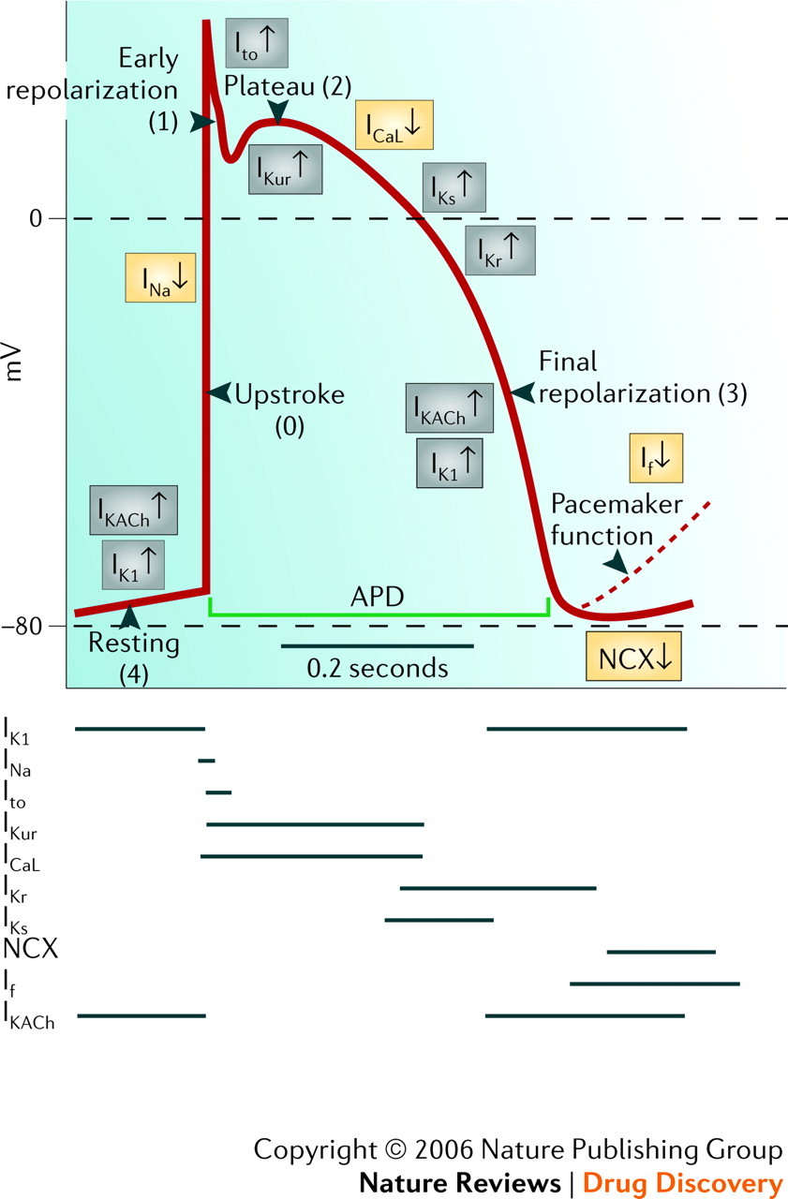

Slide 21
Slow response action potential
Seen in SA node and AV node
More depolarised E_{m} at the onset of phase 4(-50 to -65mV)
Characterised by slow upstroke phase 0
Mediated by I_{CaL} instead of I_{Na}

Slide 22
Phase 4 : Diastolic depolarisation
SA node and AV node exhibits variable E_{m}
E_{m} progressively decline during diastole
Once it reaches -40mV, action potential generated
Due to funny current, I_{f} which is a inwardly directed current
Funny current is mainly driven by Na⁺ ions and K⁺ channel to a lesser extent
Funny current deactivate during action potential
Ca²⁺ channels are also thought to play role in diastolic depolarisation

Slide 23
Phase 0: the upstroke-slow depolarisation
Mainly driven by I_{CaL}.
I_{Na} is mostly inactive at phase 0 in SA and AV node
I_{CaL} is a slow peaking channel
SA node shows slowly peaked upstroke

Slide 25
What does this magic?

Slide 26
Cardiac ion channels

Slide 27
Cardiac action potential generation and propagation depends on presence and activity of various ion channels
This ion channels are characterised by their variable distribution throughout cardiac tissue
This variability gives cardiac action potential its heterogeneity

Slide 28
Cardiac ion channels are differentiated on the basis of their permeability to different ions and their gating pathways
Movement of ion is guided by its concentration difference across the cell membrane

Slide 29
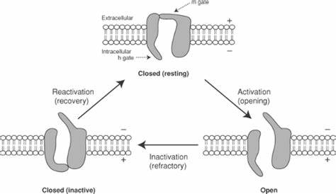
Ions channels switches between different state that determines their permeability to an ion

Slide 30
The ion channels opens and closes by the mechanism of gating
According to gating mechanism cardiac ion channels are classified as

Slide 31
Major cardiac on channels
Sodium channels
Potassium channels
Calcium channels

Slide 32
Sodium Channels
typical example of voltage-gated ion channels
The I_{Na} determines excitability and conduction in atrial, His-Purkinje system (HPS), and ventricular myocardium
Na⁺ entry also modulates intracellular Na⁺ levels, intracellular Ca²⁺ concentration and cell contraction.

Slide 33
contributes in the plateau phase (phase 2)
determine the duration of the action potential
determine the frequency of action potential firing
Pharmacological aspect
targets for the action of class I antiarrhythmic drugs.
blockade decreases tissue excitability and conductance velocity
Class IC drugs (flecainide and propafenone) block both the open and inactivated state Na⁺ channels

Slide 34
The class IB agents (lidocaine, mexiletine, and tocainide) block both open and inactivated Na⁺ channels
class IB drugs exhibit minimal or no effects on the Na⁺ channels in normal tissue
causes significant conduction slowing in depolarized tissue, especially at faster depolarization rates.
Class IA drugs (quinidine, procainamide, and disopyramide) exhibit open state block, have intermediate effects on Na⁺ channels

Slide 35
Clinical aspect
congenital LQTS (LQT3), caused by gain-of-function mutations on the Na⁺ channel gene, SCN5A
accounts for approximately 8% of congenital LQTS cases
QT prolongation and the risk of developing arrhythmia are more pronounced at slow heart rates
LQT9 is caused by gain-of-function mutations on the CAV3 gene
LOF mutation of SCN5A gene : type 1 brugada syndrome

Slide 36
LQT10 - loss-of-function mutations on the SCN4B gene,
Loss-of-function SCN5A mutations-familial forms of progressive cardiac conduction disease characterized by
a) slowing of electrical conduction through the atria, AVN, His bundle, Purkinje fibers, and ventricles
b) age-related degenerative process and fibrosis of the cardiac conduction system, in the absence of structural or systemic disease
Gain-of-function mutations in SCN5A : the most prevalent genetic cause of SIDS

Slide 37
Potassium channels
K⁺ channels represent the most diverse class of cardiac ion channels
categorized as voltage-gated (K_{v}) and ligand-gated channels.
regulate the resting E_{m}
the frequency of pacemaker cells
shape and duration of the cardiac action potential

Slide 38
Transient Outward Potassium Current (I_{to})
I_{to} is a prominent repolarizing current
shapes the rapid (phase 1) repolarization
sets the height of the initial plateau (phase 2)
2 phenotypes
1.I_{to} fast (I_{to,f})
2.I_{to} slow (I_{to,s})
I_{to} density are much higher in the epicardium and mid-myocardium than in the endocardium
Transient outward channels are subject to α- and β-adrenergic regulation.

Slide 39
Pharmacological aspect
Quinidine, 4-aminopyridine, flecainide, and propafenone blocks the channel and accelerate I_{to} inactivation
I_{to} blockers can potentially prolong the action potential duration in the atrial and in ischemic ventricular myocardium
Clinical aspect
myocardial ischemia, MI, dilated cardiomyopathy, and end-stage heart failure cause downregulation of I_{to}
The reduction in I_{to} results in prolongation and increased heterogeneity of action potential duration

Slide 40
development of a marked dispersion of repolarization
which provides the substrate for reentrant arrhythmias
predisposes to ventricular arrhythmias and SCD
I_{to} is reduced in
Chronic AF
Hypothyroidism
Diabetes

Slide 41
Ultrarapidly Activating Delayed Outward Rectifying Current (I_{Kur})
I_{Kur} activates rapidly on depolarization in the plateau range and displays outward rectification
inactivates very slowly
detected only in human atria and not in the ventricles
basis for the much shorter duration of the action potential in the atrium.
Lead to the less positive plateau phase in atrial compared with ventricular cardiomyocytes

Slide 43
I_{Kur} is highly sensitive to 4-aminopyridine
relatively insensitive to class III anti-arrhythmics
Vernakalant is a I_{kur} channel blocker and is atrium specific
Hence terminates AF without affecting ventricles

Slide 44
Rapidly Activating Delayed Outward Rectifying Current (I_{Kr})
I_{Kr} is the principal repolarizing current at the end of the plateau phase
Governs the cardiac action potential duration and refractoriness.
I_{Kr} progressively increase in phases 2 and 3
maximal current before the final rapid declining phase of the action potential.
Beta adrenergic stimulation enhances while alpha adrenergic stimulation diminishes I_{kr}

Slide 45
Pharmacological aspect
K_{r} is the target of class III antiarrhythmic drugs of the methanesulfonanilide group (almokalant, dofetilide, d-sotalol, ibutilide)
I_{Kr} blockers
prolong atrial and ventricular action potential duration
increases refractoriness
no significant changes in conduction velocity
I_{Kr} is blocked by variety of drugs and is the major cause for drug induced long QT syndromes

Slide 46
Clinical aspect
Hyperkalemia enhances while hypokalemia diminishes I_{kr}
LQT2(second most prevalent type of LQTS) caused by KCNH2 [HERG] loss-of-function mutations)
LQT6 (caused by KCNE2 [MiRP1] mutations)
Gain of function mutation in I_{kr} is associated with short QT syndrome

Slide 47
Both hyperglycemia and hypoglycemia depress I_{Kr}
I_{Kr} amplitude increases on elevation of extracellular K⁺ concentrations

Slide 48
Slowly Activating Delayed Outward Rectifying Current (I_{Ks})
I_{Ks} contributes to human atrial and ventricular repolarization
I_{Ks} contributes most during late plateau phase.
important role in determining the rate-dependent shortening of the cardiac action potential
As heart rate increases, I_{Ks} increases
safeguard against loss of repolarizing power

Slide 49
Pharmacological aspect
selectively blocked by indapamide, thiopentone, propofol, and benzodiazepines.
I_{Ks} accumulates at fast driving rates because of its slow deactivation
I_{Ks} blockers can be expected to be more effective in prolonging action potential duration and refractoriness at fast rates

Slide 50
Clinical aspect
LQT1(most common type of LQTS), is caused by autosomal dominant loss-of-function mutations on the KCNQ1 gene
Romano Ward syndrome(AD)
Lange- Nielson syndrome(AR)
LQT11 is caused by loss-of-function mutations on the AKAP9 gene
SQT2 is caused by mutations on the KCNQ1 gene (KvLQT1)
Heart failure reduces I_{Ks} in atrial, ventricular, and sinus node myocytes account for the prolonged action potential duration in heart failure.

Slide 51
Inward Rectifying Current (I_{K1})
I_{K1} sets and stabilizes the resting E_{m}
regulates cellular excitability of atrial and ventricular myocytes during phase 4
I_{K1} channels close on depolarization.
I_{K1} limits the outward current during phases 0, 1, and 2
allows membrane depolarization , slows membrane repolarization, and prolongs cardiac action potential
I_{K1} is almost absent in sinus node and AVN cells
relatively more depolarized resting diastolic potentials

Slide 52
Clinical aspect
loss-of-function mutations of KCNJ2 gene encoding Kir2 →Andersen-Tawil syndrome (LQT7), a rare autosomal dominant disorder characterized by the triad of
skeletal developmental abnormalities,
periodic paralysis
ventricular arrhythmias

Slide 53
Catecholaminergic polymorphic VT due to LOF mutation
Characterized by prominent U Wave, ventricular ectopy, polymorphic VT
A gain-of-function mutation of KCNJ2 → SQTS type 3 (SQT3)
gain-of-function KCNJ2 mutation → familial AF.
I_{K1} is downregulated in patients with severe heart failure and cardiomyopathy

Slide 54
Acetylcholine-Activated Potassium Current (I_{KACh})
I_{KACh} is more prominent in atrial tissue, as well as in the sinus node and AVN
absent in the ventricles
I_{KACh} mediates vagal influences on sinus rate and atrial repolarization, as well as AVN conduction
hyperpolarizes the E_{m} and shortens action potential duration.
slowing of phase 4 depolarization,
reduction in the spontaneous firing rate of the pacemaker cells of the sinus node and AVN, and slowing of AVN conduction

Slide 55
LQT13 is caused by loss-of-function mutations on the KCNJ5 gene.
I_{KACh} is constitutively active in chronic AF

Slide 56
ATP dependent potassium current(IK_{ATP})
Ligand gated K⁺channel
Regulated by ATP/ADP ratio
Inhibited by increased intracellular ATP
Couples cellular metabolism to Em

Slide 57
Gets activated during the time of metabolic stress
abbreviates action potential duration and reduces Ca²⁺entry
depress muscle contractility and conserve energy
Plays role in ischemic preconditioning
K_{ATP} channel opener like Nicorandil shortens action potential duration
Suppresses EAD and DAD in patients with LQTS
K_{ATP} channel blocker inhibits hypoxia induced shortening of AP and prevents development of VT

Slide 58
L-Type Calcium Current (I_{CaL})
Found in all types of cardiac cells
largely responsible for the action potential plateau
major determinant of the duration of the plateau phase and hence of action potential duration and refractoriness.
also links membrane depolarization to myocardial contraction
I_{CaL} is responsible for the upstroke (phase 0) of slow response action potentials
Target of class IV antiarhythmics

Slide 59
Clinical aspect
Gain-of-function mutations of the CACNA1C gene leads to inappropriate continuation of I_{CaL} (Timothy syndrome)
Prolongs AP duration
EADs and DADs
Approximately 12% of cases of the Brugada syndrome→ loss-of-function mutations in the cardiac Ca²⁺ channel ,

Slide 60
Brugada syndrome type 3-- CACNA1C gene, which encodes the pore-forming α1 subunit (Cav1.2).
Brugada syndrome type 4 is caused by mutations in the CACNB2 gene
SQT4 is caused by mutations on the CACNA1C gene
I_{CaL} is downregulated in AF

Slide 61
T-Type Calcium Current (I_{CaT} )
T-type channels are abundant in sinus node pacemaker cells and Purkinje fibers of many species
important for maintenance of pacemaker activity by setting the frequency of action potential firing
it has been suggested that T-type Ca²⁺ channels play a role in generating pacemaker depolarization and contribute to automaticity

Slide 62
Cardiac Pacemaker Current (I_{f})
Hyperpolarization-activated cyclic nucleotide-gated (HCN) channels.
I_{f} is a mixed Na⁺-K⁺ current, with a threefold higher selectivity for Na+ than for K⁺
HCN channels are activated on hyperpolarization
I_{f} conducts an inward current during phases 3 and 4 of the action potential and underlie slow membrane depolarization in cells with pacemaker activity

Slide 63
major player in both generation of spontaneous activity and rate control of cardiac pacemaker cells(pacemaker current)
begin to activate at the end of the action potential
HCN2/HCN4 expression is upregulated in
AF
ventricular hypertrophy
congestive heart failure
Ivabradine, a selective I_{f} blocker is used for the treatment of IHD, Systolic HF, inappropiate sinus tachycardia

Slide 64
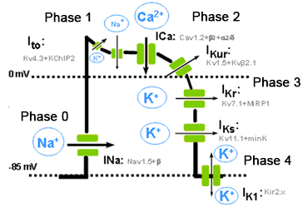

Slide 66
Heterogeneity of action potential within cardiac cells

Slide 67
Cardiac chanellopathies

Slide 68
Summary
Cardiac action potential is different from other action potentials
There is heterogeneity of action potential within cardiac tissue
Ion channels are the show runner for the generation and propagation of action potential
There are 5 phases in a cardiac action potential
These phases are due to variable activity of cardiac ion channels
Cardiac ion channels are the site of defect in various congenital and acquired heart disease
Ion channels are the target of various drugs used to treat arrhythmias and heart diseases.

